Slide 1
Boruta Algorithm
Daniel Centurion Barrionuevo Vamsi Krishna Garapati

Slide 2
What it is?
Boruta is a wrapper method built around Random Forest to identify all important features in a dataset.
Key Idea:
Compares original features with randomized versions (shadow features).
Marks features as important or unimportant based on statistical tests.

Slide 3


Step 1 – Generate Shadow Features
$$X=\left[\begin{matrix}1.1 & 10 & 0 & 53 \\ 1.3 & 12 & 0 & 45 \\ 0.9 & 8 & 1 & 32 \\ 1.5 & 20 & 0 & 70\end{matrix}\right]$$
Random Shuffle each feature column
$$X_{shadow}=\left[\begin{matrix}1.3 & 20 & 1 & 32 \\ 1.1 & 8 & 0 & 70 \\ 1.5 & 12 & 0 & 45 \\ 0.9 & 10 & 0 & 32\end{matrix}\right]$$

Slide 4
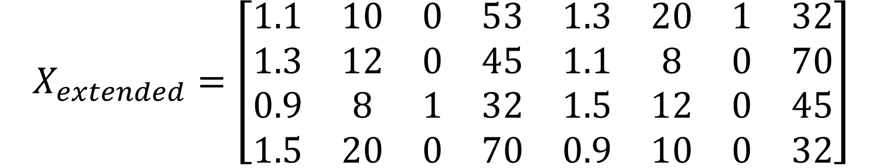
Step 3 – Concatenate Original and Shadow Features
$$X_{extended}=\left[\begin{matrix}1.1 & 10 & 0 & 53 & 1.3 & 20 & 1 & 32 \\ 1.3 & 12 & 0 & 45 & 1.1 & 8 & 0 & 70 \\ 0.9 & 8 & 1 & 32 & 1.5 & 12 & 0 & 45 \\ 1.5 & 20 & 0 & 70 & 0.9 & 10 & 0 & 32\end{matrix}\right]$$
Original features
Shadow features

Slide 5
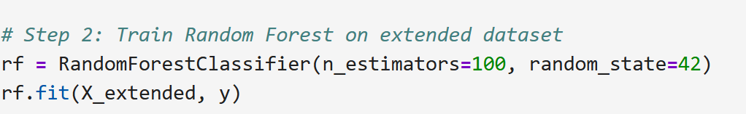
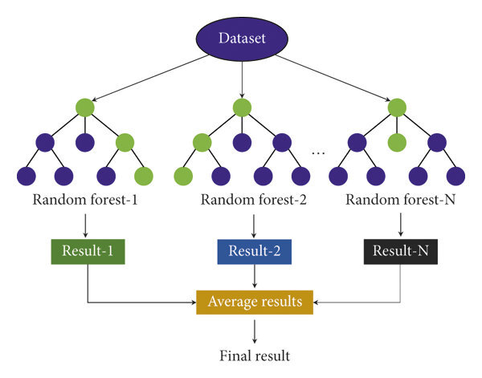
Step 4 – Random Forest Training with extended data
$$X_{extended}$$
$$y$$
Mohanty, Adyasha & Gao, Grace. (2024). A Survey of Machine Learning Techniques for Improving Global Navigation Satellite Systems.

Slide 6
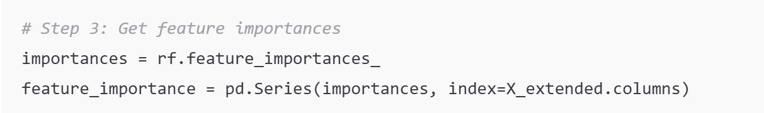
Step 5 – Features Importances
$$X_{extended}$$
$$f_{importance}$$
$$y$$
Mohanty, Adyasha & Gao, Grace. (2024). A Survey of Machine Learning Techniques for Improving Global Navigation Satellite Systems.

Slide 7
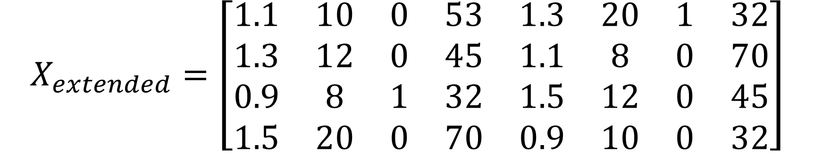
Step 6 – Features Importances Comparison
$$X_{extended}=\left[\begin{matrix}1.1 & 10 & 0 & 53 & 1.3 & 20 & 1 & 32 \\ 1.3 & 12 & 0 & 45 & 1.1 & 8 & 0 & 70 \\ 0.9 & 8 & 1 & 32 & 1.5 & 12 & 0 & 45 \\ 1.5 & 20 & 0 & 70 & 0.9 & 10 & 0 & 32\end{matrix}\right]$$
$$f_{importance}=\left[\begin{matrix}0.3 & 0.4 & 0.1 & 0.05 & 0.02 & 0.06 & 0.05 & 0.02\end{matrix}\right]$$
Original features importance
Shadow features importance

Slide 8

Step 6 – Features Importances Comparison
$$X_{extended}=\left[\begin{matrix}1.1 & 10 & 0 & 53 & 1.3 & 20 & 1 & 32 \\ 1.3 & 12 & 0 & 45 & 1.1 & 8 & 0 & 70 \\ 0.9 & 8 & 1 & 32 & 1.5 & 12 & 0 & 45 \\ 1.5 & 20 & 0 & 70 & 0.9 & 10 & 0 & 32\end{matrix}\right]$$
$$f_{importance}=\left[\begin{matrix}0.3 & 0.4 & 0.1 & 0.05 & 0.02 & 0.06 & 0.05 & 0.02\end{matrix}\right]$$
Confirmed or rejected
Max value = 0.06

Slide 9

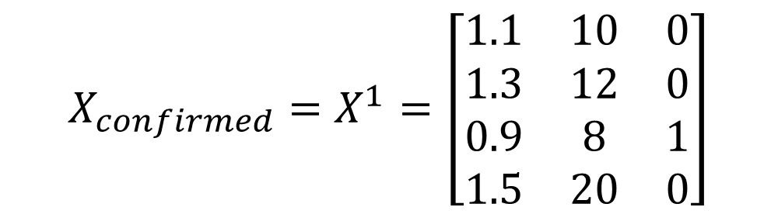

Step 7 – Repeat until all features are confirmed or rejected
$$X_{confirmed}=X^{1}=\left[\begin{matrix}1.1 & 10 & 0 \\ 1.3 & 12 & 0 \\ 0.9 & 8 & 1 \\ 1.5 & 20 & 0\end{matrix}\right]$$
Yes
$$X^{k}$$
Repeat all steps
All features confirmed or rejected?
Stop
$$X^{k+1}$$
No

Slide 10
Tentative Features Treatment
Tentative features are those for which Boruta cannot confidently decide whether they are important or unimportant.
Their importances are not consistently above or below the shadow features across iterations.
1. TentativeRoughFix (BorutaPy or Boruta R package)
A post-processing step where tentative features are re-evaluated using median importance over all iterations.
If their median importance is higher than the median of shadow features, mark as important, otherwise unimportant.
This is the default recommended way to resolve tentative features.
2 . Modeling
Final model (e.g., Random Forest, XGBoost, Neural Net) decides their usefulness.
3 . Domain knowledge filtering
Sometimes, tentative features may have strong theoretical or practical justification. In such cases, domain expertise can help retain or drop them.

Slide 11
Observations
Each step could be repeated multiple times (N iterations) to improve stability. A counting system tracks how often a feature is marked important or unimportant.
Boruta was originally built around Random Forest, but it is not strictly limited to it. Any model that provides a reliable measure of feature importance can be used. Examples: Extra Trees, XGBoost, LightGBM, or other models with feature scoring.

